Slide 1


SHARKTANK
SQL CASE STUDY
PRESENTED BY – Nitin Patial

Slide 2
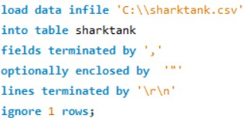
ETL - EXTRACT TRANSFORM LOAD
Data fetch - Kaggle
Data was uncleaned . Performed data-cleaning on Python
After the data was cleaned, tried to load the data to MySQL Workbench but the data was failed to import.
Performed below SQL query and loaded the data into table “sharktank”

Slide 3
ABOUT THE SCHEMA
Database - projects
Table - sharktank
Total entries after cleaning - 478 Total columns - 42

Slide 4
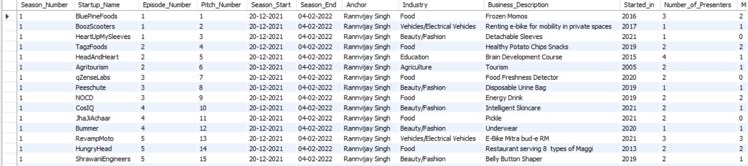
DATA VIEW
select * from sharktank

Slide 5
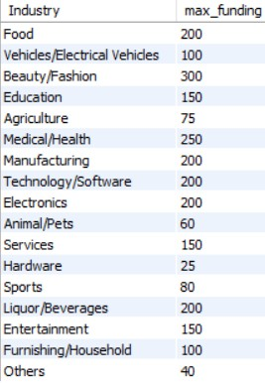
ANSWERING THE QUESTIONS
1 - You Team must promote shark Tank India season 4, The senior come up with the idea to show highest funding domain wise so that new startups can be attracted, and you were assigned the task to show the same.
select
Industry,
MAX(Total_Deal_Amount_in_lakhs) as "max_funding" from sharktank
group by Industry;

Slide 6

ANSWERING THE QUESTIONS
2 - You have been assigned the role of finding the domain where female as pitchers have female to male pitcher ratio >70%
select
Industry, (females/males)*100 as "ratio"
from (select
Industry, sum(Male_Presenters) as "males" , sum(Female_Presenters) as "females”
from sharktank group by Industry
having sum(Male_Presenters)>0 and sum(Female_Presenters)>0) t where (females/males)*100 >70;

Slide 7
ANSWERING THE QUESTIONS
3 - You are working at marketing firm of Shark Tank India, you have got the task to determine volume of per season sale pitch made, pitches who received offer and pitches that were converted. Also show the percentage of pitches converted and percentage of pitches entertained.
select
a.Season_Number, a.total, b.received, c.accepted , (b.received/a.total)*100 as "entertained_%", (c.accepted/a.total)*100 as "converted_%"
from
(select Season_Number, count(Pitch_Number) as "total" from sharktank
group by Season_Number) a join
(select Season_Number,count(Pitch_Number) as "received" from sharktank
where Received_Offer="Yes" group by Season_Number) b
on a.Season_Number=b.Season_Number join
(select Season_Number,count(Pitch_Number) as "accepted" from sharktank where Accepted_Offer="Yes"
group by Season_Number) c
on b.season_number=c.season_number;
Output is on Next Page

Slide 8

ANSWERING THE QUESTIONS

Slide 9
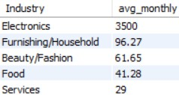
ANSWERING THE QUESTIONS
4 - As a venture capital firm specializing in investing in startups featured on a renowned entrepreneurship TV show, you are determining the season with the highest average monthly sales and identify the top 5 industries with the highest average monthly sales during that season to optimize investment decisions?
set @season =(select
Season_Number from sharktank group by 1
order by round(avg(Monthly_Sales_in_lakhs),2) desc limit 1);
select
Industry, round(avg(Monthly_Sales_in_lakhs),2) as "avg_monthly" from sharktank
where Season_Number=@season group by Industry
order by round(avg(Monthly_Sales_in_lakhs),2) desc limit 5;

Slide 10
ANSWERING THE QUESTIONS
5. As a data scientist at our firm, your role involves solving real-world challenges like identifying industries with consistent increases in funds raised over multiple seasons. This requires focusing on industries where data is available across all three seasons. Once these industries are pinpointed, your task is to delve into the specifics, analyzing the number of pitches made, offers received, and offers converted per season within each industry.
with cte as
(select Industry, max(case
when Season_Number=1 then Total_Deal_Amount_in_lakhs else null end) as
"Season_1", max(case
when Season_Number=2 then Total_Deal_Amount_in_lakhs else null end) as "Season_2",
max(case
when Season_Number=3 then Total_Deal_Amount_in_lakhs else null end) as "Season_3"
from sharktank group by Industry
having Season_2>Season_1 and Season_3>Season_2 and Season_1!=0)
(Making a cte first) )

Slide 11
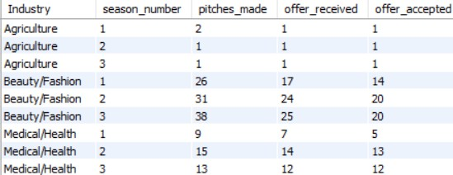
ANSWERING THE QUESTIONS
select
Industry,season_number ,count(Pitch_Number) as "pitches_made" , sum(case when Received_Offer="Yes" then 1 else 0 end) as "offer_received", sum(case when Accepted_Offer="Yes" then 1 else 0 end) as "offer_accepted"
from sharktank
where Industry in (select Industry from cte) group by 1,2
order by 1,2;
(Using the cte as a subquery))

Slide 12
ANSWERING THE QUESTIONS
6 - Every shark wants to know in how much year their investment will be returned, so you must create a system for them, where shark will enter the name of the startup’s and the based on the total deal and equity given in how many years their principal amount will be returned and make their investment decisions.
(For this question, we need to create a stored procedure))
CREATE DEFINER=`root`@`localhost` PROCEDURE `TOT`(IN startup VARCHAR(255)) BEGIN

Slide 13
ANSWERING THE QUESTIONS
CASE
WHEN (SELECT Accepted_offer = 'Not Received' FROM sharktank WHERE Startup_Name = startup) THEN
SELECT 'Unable to fetch TOT. Offer not accepted.';
WHEN (SELECT Accepted_offer = 'Yes' AND Yearly_Revenue_in_lakhs = 'Not Mentioned' FROM sharktank WHERE Startup_Name = startup)
THEN
SELECT 'Unable to fetch TOT. Yearly_Revenue not mentioned.'; ELSE
SELECT `Startup_Name`,
`Yearly_Revenue_in_lakhs`,
`Total_Deal_Amount_in_lakhs`,
`Total_Deal_Equity_in_%`,
`Total_Deal_Amount_in_lakhs` / (`Total_Deal_Equity_in_%` * `Yearly_Revenue_in_lakhs`) AS 'TOT' FROM sharktank
WHERE Startup_Name = startup; END CASE;

Slide 14

ANSWERING THE QUESTIONS
SELECT result AS 'TOT'; END
CALL TOT('HeadAndHeart');
CALL TOT(‘BluePinesfood');

Slide 15
ANSWERING THE QUESTIONS
7. In the world of startup investing, we're curious to know which big-name investor, often referred to as "sharks," tends to put the most money into each deal on average. This comparison helps us see who's the most generous with their investments and how they measure up against their fellow investors.
select
avg(case when Namita_Investment_Amount_in_lakhs>0 then Namita_Investment_Amount_in_lakhs else null end ) as "Avg_Namita",
avg(case when Vineeta_Investment_Amount_in_lakhs>0 then Vineeta_Investment_Amount_in_lakhs else null end ) as "Avg_Vineeta",
avg(case when Aman_Investment_Amount_in_lakhs>0 then Aman_Investment_Amount_in_lakhs else null end ) as "Avg_Aman" , avg(case when Anupam_Investment_Amount_in_lakhs>0 then Anupam_Investment_Amount_in_lakhs else null end ) as
"Avg_Anupam",
avg(case when Peyush_Investment_Amount_in_lakhs>0 then Peyush_Investment_Amount_in_lakhs else null end ) as "Avg_Peyush",
avg(case when Ashneer_Investment_Amount_in_lakhs>0 then Ashneer_Investment_Amount_in_lakhs else null end ) as "Avg_Ashneer",
avg(case when Amit_Investment_Amount_in_lakhs>0 then Amit_Investment_Amount_in_lakhs else null end ) as "Avg_Amit"from sharktank
where Received_Offer="Yes" ;

Slide 16
ANSWERING THE QUESTIONS

Slide 17
ANSWERING THE QUESTIONS
)
8. In the realm of venture capital, we're exploring which shark possesses the most diversified investment portfolio across various industries. By examining their investment patterns and preferences, we aim to uncover any discernible trends or strategies that may shed light on their decision-making processes and investment philosophies.
with cte AS (SELECT
'Namita' AS sharkname, Industry FROM
sharktank WHERE
Namita_Investment_Amount_in_lakhs > 0
UNION ALL SELECT
'Vineeta' AS sharkname, Industry FROM
sharktank WHERE
Vineeta_Investment_Amount_in_lakhs > 0

Slide 18
ANSW⁾ ERING THE QUESTIONS
UNION ALL
SELECT
'Anupam' AS sharkname, Industry FROM
sharktank WHERE
Anupam_Investment_Amount_in_lakhs > 0
(using set operation - UNION ALL )
UNION ALL
SELECT
'Aman' AS sharkname, Industry FROM
sharktank WHERE
Aman_Investment_Amount_in_lakhs > 0
UNION ALL

Slide 19
ANSWERING THE QUESTIONS
)
SELECT
'Peyush' AS sharkname, Industry FROM
sharktank WHERE
Peyush_Investment_Amount_in_lakhs > 0
UNION ALL SELECT
'Amit' AS sharkname, Industry FROM
sharktank WHERE
Amit_Investment_Amount_in_lakhs > 0 UNION ALL

Slide 20
ANS⁾WERING THE QUESTIONS
SELECT
'Ashneer' AS sharkname, Industry FROM
sharktank WHERE
Ashneer_Investment_Amount_in_lakhs > 0
(extracting result from the cte)
select *,
dense_rank() over(order by num_unique_industries desc) as "diversification_rank" from
(select
sharkname,count(distinct Industry) as "num_Unique_industries" from cte
group by sharkname) t;

Slide 21
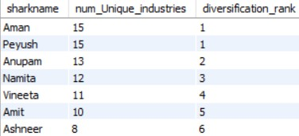
ANS⁾WERING THE QUESTIONS

